Slide 1
GLoCALL 2015 @Pai Chai University, Conference, November 12-14, 2015 Effects of Observing Model Video Presentation on Japanese EFL Learners’ Oral Performance
Yasuko Okada, Seisen University, Japan
Takehiko Ito, Wako University, Japan
Takafumi Sawaumi, Kanagawa University, Japan
Notes:
Good morning and thank you for coming to our presentation.
I’m Yasuko Okada, the first author of the study.
The title in the program was based on the preliminary analysis of our data.
After working on this paper, we found that it might be more interesting to focus on how model-video presentations affected learners’ oral performance.
Thus, in this presentation, we’re going to talk about effects of observing model video presentation on Japanese learners’ oral performances.

Slide 2
Outline
Previous studies
Method
Results
Discussion
Conclusions
Notes:
First, I will explain the previous studies.
After explaining the method, I will show you the results and then conclude the presentation.

Slide 3
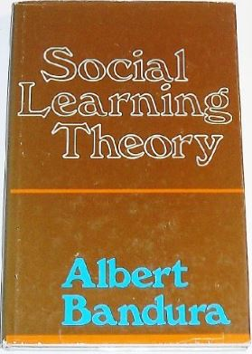
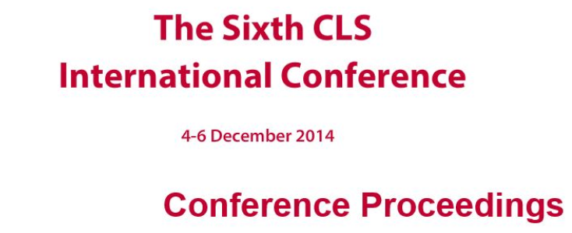
Outline
Previous studies
Method
Results
Discussion
Conclusions
Notes:
Let me begin with the previous studies.

Slide 4
Observational learning: Bandura(1977)
One of social learning theories .
People observe others and acquire a new human behavior by modeling them.
When people observe an inappropriate model, they would not imitate it because a negative effect would be expected.
People’s cognitive skills should be developed by observing both appropriate and inappropriate models.
Notes:
This study is based on one of social learning theories proposed by Bandura.
According to him, people observe others and acquire a new human behavior by modeling them.
He also insists that, when people observe an inappropriate model, they would not imitate it because a negative effect would be expected.
So, we assume that people’s cognitive skills should be developed by observing both appropriate and inappropriate models.

Slide 5
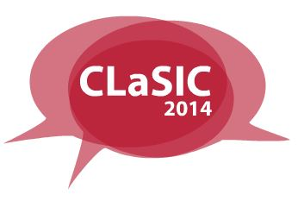
Observational learning: Okada, Sawaumi, & Ito (2014)
Japanese university students (N = 29) in an EFL context
Compared between high and low English proficiency groups.
Model video clips were selected from video-recorded presentations of students.
Successful model videos were shown to both groups.
Notes:
In line with Bandura’s theory, we conducted a study in 2014.
In our study, Japanese university students who were in high and low English proficiency groups were compared using successful model videos.
Model video clips were selected from video-recorded presentations of the students who had taken the course earlier.
Among these recorded presentations, excellent performance videos were considered successful model videos and shown to both groups.

Slide 6
Observational learning (cont’d)
Observing model video was effective for high proficiency group, but intimidated low proficiency learners
There was a large gap of English ability between the model video and their own.
Notes:
The study concluded that observing model videos was effective for high proficiency learners but intimidated low proficiency ones because there was a large gap of English ability between the model video and their own.

Slide 7
Aptitude Treatment Interaction (ATI)
A pedagogical concept proposed by Cronbach & Snow (1977)
Interaction effects between teaching methods and learners’ aptitudes on maximizing instructional effect.
Research of ATI is not robust (Namiki, 1993).
Notes:
Another framework we applied in this study is aptitude treatment interaction.
This is a pedagogical concept proposed by Cronbach and Snow.
In ATI studies, researchers are trying to find interaction effects between teaching methods and learners’ aptitudes to maximize instructional effect.
As Namiki stresses that ATI research is not robust, it may not be easy to find an interaction effect between the treatments and aptitudes.

Slide 8
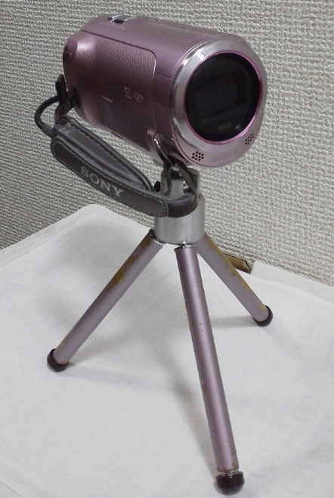
Research Aims
To investigate an interaction effect between types of model video presentations (successful vs. average) and levels of English proficiency (high vs. low) using self- and peer-evaluation.
To examine whether not only successful model videos but also average presentations enable students to develop their cognitive skills.
Notes:
Based on the previous studies, we set two research aims for this study.
First is to investigate an interaction effect between types of model video presentations and levels of English proficiency using self- and peer-evaluation.
Second is to examine whether not only successful model videos but also average presentations enable students to develop their cognitive skills.

Slide 9
Outline
Previous studies
Method
Results
Discussion
Conclusions
Notes:
Next, I will explain the method of the present study.

Slide 10
Participants
Twenty-seven Japanese university students.
Enrolled in 2 classes of English communication in Spring 2015.
All were freshmen majoring in economics.
Notes:
In this study, 27 students were participants. These students were enrolled in two classes of English communication in Spring 2015.
All students were freshmen and majoring in economics.

Slide 11
Two Classes
Class A: 12 students
Class B: 15 students
Placed into each class based on their scores of TOEIC Bridge test.
Class size & Student test scores: No significant difference
Taught by the same instructor (the first author).
Notes:
Of 27 students, there were 12 students in Class A and 15 in Class B.
These students were placed into each class based on their scores of TOEIC Bridge test.
For class size and students’ test scores, there was no significant difference between the classes.
And both classes were taught by the same instructor.

Slide 12
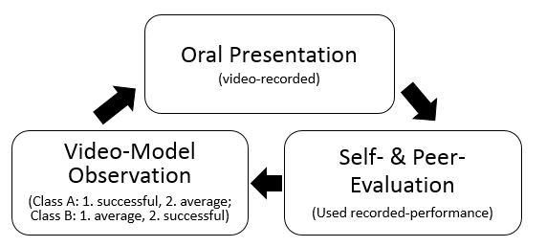
Data Collection Procedures
Three oral presentation were administered.
Memorized each topic
180-200 words
Taught how to maintain good posture, eye contact, as well as English pronunciation, rhythm, and intonation.
Notes:
In the research project, students performed three oral presentations.
Each memorized presentation was 180-200 words.
Throughout the course, students were taught how to maintain good posture and eye contact as well as English pronunciation, rhythm, and intonation.
This ongoing instruction prepared students to assess these aspects when evaluating their own and their peers’ performances.

Slide 13
Research Design
Quasi-experimental design
Revised nonequivalent groups pretest-posttest design
O: Evaluation (first, second, third self- & peer-evaluation)
X: Treatment (successful model video vs. average model video)
Notes:
Since this was as part of regular English lessons at the university and didn’t use random assignment to create the groups, quasi-experimental design was used.
We also decided to revise one of the test designs to fit the current study.
In the slide, a large O indicates evaluation, which is the first, second, third self- and peer evaluations in the study.
A large X means treatment, which is successful and average model video observations in the study.

Slide 14
Presentation Cycle
Oral Presentation
(video-recorded)
Model Video Observation
(Class A: 1. successful, 2. average; Class B: 1. average, 2. successful)
Self- & Peer- Evaluation
(while watching recorded-performance)
Notes:
This slide shows a simplified version of the presentation cycle.
What is important here is that, for the first video observation, Class A watched successful model videos and Class B for average presentations.
For the second observation, Class A watched average model videos and Class B for successful ones.

Slide 15
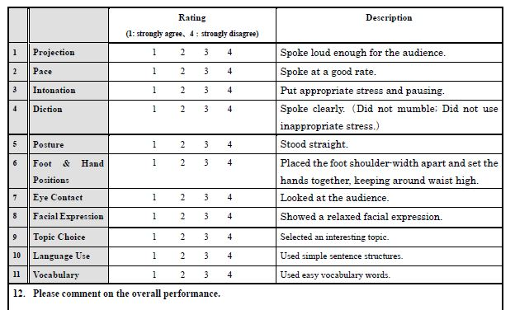
Instruments: Quantitative Data
Evaluation Form in
Japanese
Items 1-4: Voice Control
Item 5-8: Body Language
Items 9-11: Effectiveness
4-point Likert-type scale
Notes:
There were two instruments used for the study.
One is self- and peer-evaluation scores for all presentations.
There were 11 evaluation items in the form.
Voice control included projection, pace, intonation, and diction.
Body language included posture, foot & hand positions, eye contact, and facial expression.
And effectiveness included topic choice, language use, and vocabulary.
Descriptions were also included in the form so that students could understand the points in order to assess their own and their peers’ performances objectively.
To rate each aspect of the performance, a 4 point Likert-type scale was used.

Slide 16
Instruments (Quantitative & Qualitative Data)
Model Video Review
Student Performance Reflection
Video observation reflection
Notes:
Another instruments used in the study were three kinds of open-ended question forms.
First, in the model video review, students wrote strengths and weaknesses of the model speakers on video.
Second, the student performance reflection was used when their second and third presentations were completed to reflect on their performance outcomes. They were asked to write about how model video observation affected their own performance.
Finally, the video observation reflection was used when all the procedures were completed. In the form, students were asked to comment on how they perceived observing successful and average model videos.
In addition, the degree of difficulty of each topic was compared, using a 5 point likert scale, to make sure that there was no significant difference between the three topics.

Slide 17
Outline
Previous studies
Method
Results
Discussion
Conclusions
Notes:
Now let’s take a look at the results of the analyses.

Slide 18
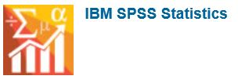
Data Analysis Scheme
English proficiency group as an independent variable.
Repeated measures ANOVA
Class (Class A vs. Class B) and Proficiency (high vs. low) as between-participants factors.
Time of presentation (first vs. second vs. third) as a within-participant factor.
3 subscales were used: voice control, body language, effectiveness
IBM SPSS 22.0 was used.
Notes:
In the study, we used mixed methods research to analyze data.
As we mentioned earlier, there was no significant difference of the English test scores between the two classes.
So, each class was divided into two groups according to the test scores to compare high and low proficiency groups. There was no significant difference of test scores between the two groups.
The English proficiency group was used as an independent variable.
Repeated measures ANOVA was performed to examine the mean differences in self- and peer-evaluation scores, between Class and Proficiency as between-participants factors, and Time of presentation as a within-participant factor.
The 11 items of evaluation were aggregated and used as three subscales.
To analyze quantitative data, SPSS 22 was used.

Slide 19
Results of ANOVA
Notes:
Now, let’s take a look at the results of analysis of self- and peer-evaluated scores.
First, for self-evaluation, a significant interaction effect of Time and Proficiency was observed in body language.
Next, for peer-evaluation, there were significant main effects observed in voice control, body language, effectiveness, and the overall score.
In addition, there were significant interaction effects found in voice control, effectiveness and the overall score.
In the next slide, I will focus on the highlighted result of the peer-evaluated overall score.

Slide 20
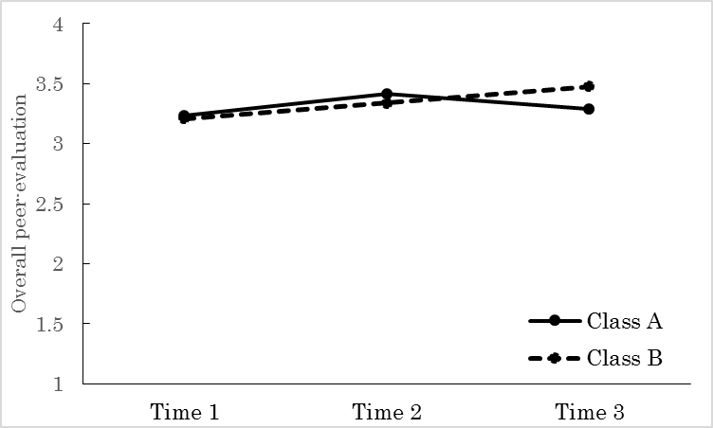
Overall Peer-Evaluation as a Function of Time & Class
Class B
Class B
Notes:
This slide shows how the overall peer-evaluated scores changed in the three presentations. Red lines show the significant differences on the analyses.
For the first presentation, the average scores for both classes look quite similar.
After watching the first model videos, Class A scored slightly higher than that of Class B for the second presentation.
However, after observing the second video presentations, Class A scored lower in the third presentation.
Instead, Class B scored higher than their second presentation, and they also scored higher than Class A in the third presentation.

Slide 21
Text Mining & Content Analyses
Text Mining Studio 5.1 by NTT Data Mathematical Systems Inc. was used.
The two classes were compared.
Student performance & video observation reflections were analyzed.
Word frequency analysis
Notes:
Next, we analyzed the text data both quantitatively and qualitatively.
For quantitative analysis, we performed text mining analysis, using Text Mining Studio 5.1.
Because the quantitative results of peer evaluation indicate significant differences between the classes, we will focus on the text data comparing the two classes.
Three kinds of text data were collected for this study, but we will focus on the student performance reflection as well as video observation one in this presentation.
For text mining analysis, we conducted word frequency analysis to determine how often each word appeared in the text.

Slide 22
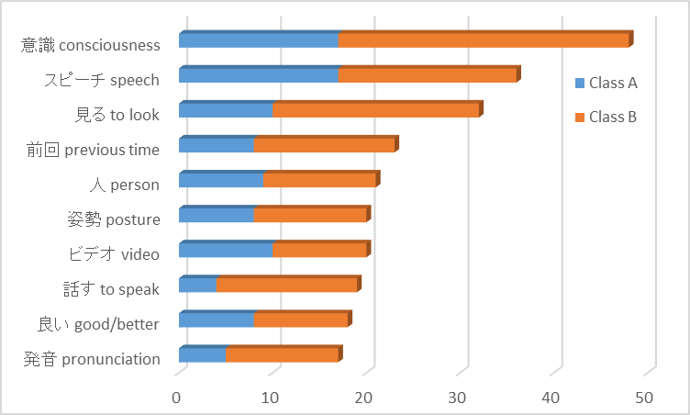
Student Performance Reflection
Notes:
First, I will show you the results of word frequency analysis of the student performance reflection, which was administered immediately after the second and third presentations.
The results indicate that students seemed to focus on what they had observed in the model videos when they made their own oral presentations.
Also, it is clear that students in the two classes referred to both visual and auditory information when reflecting on their own performance.

Slide 23
2nd Presentation Performance Reflection
Class A
“What I had learned from the (successful) model videos was to make an oral presentation with a smile.”
Class B
“From watching the (average) model video presentations, I learned that posture and eye contact were also the important factors to make the presentation impressive. Therefore, I practiced for my presentation, focusing on these aspects in addition to speaking volume.”
Notes:
Here are some examples of students’ comments on effects of model videos.
A student in Class A said “What I had learned from the model videos was to make an oral presentation with a smile.”
A student in Class B commented that, “From watching the model video presentations, I learned that posture and eye contact were also the important factors to make the presentation impressive. Therefore, I practiced my presentation, focusing on these aspects in addition to speaking volume.”

Slide 24
3rd Presentation Performance Reflection
Class A
“Although I paid attention to eye contact, I became lost when I didn’t know what to say. I could only look up the ceiling.”
Class B
“After watching the successful model videos, I worked hard to make my pronunciation better. At the presentation, I spoke as if I had been a native speaker of English.”
Notes:
Students were also asked to reflect effects of model videos on their third presentation.
A student in Class A said that “Although I paid attention to eye contact, I became lost when I didn’t know what to say. I could only look up the ceiling.”
In Class B, one student wrote “After watching the successful model videos, I worked hard to make my pronunciation better. At the presentation, I spoke as if I had been a native speaker of English.”

Slide 25
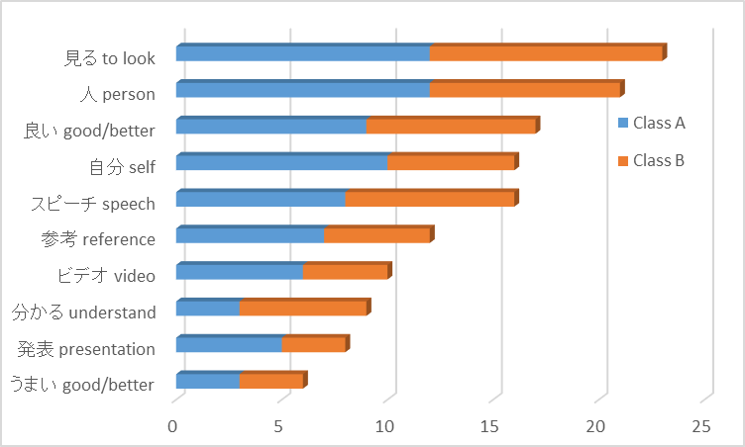
Video Observation Reflection
Notes:
Next, we will show you the results of analyzing the video observation reflection.
This slide shows the high frequency words that appeared in the text for both classes.
For example, the frequently used words that were relevant to model video observation included “speech” “video” and “presentation.”
The words “good/better” frequently appeared as a reflection of model video observation.

Slide 26
Video Observation Reflection (cont’d)
Class A
“Since there was something I wanted to imitate in the first model videos, I focused on it when practicing my presentation. The first model video presentations were very effective... For the second model videos, I could observe what I needed to improve and keep to practice for my oral presentation, paying attention to it.”
Notes:
One of the students in Class A commented that, “Since there was something I wanted to imitate in the first model videos, I focused on it when practicing my presentation.
The first model video presentations were very effective.
For the second model videos, I could observe what I needed to improve and keep to practice my presentation, focusing on it.”

Slide 27
Video Observation Reflection (cont’d)
Class B
“It was very good because I observed the video as a model when I felt I was missing something but I didn’t know how to improve it. In addition, I found a difference of my own presentations before and after model video observations.”
Notes:
In a similar way, a student in Class B stated “It was very good because I observed the video as a model when I felt I was missing something but I didn’t know how to improve it. In addition, I found a difference of my own presentations before and after watching model video.”

Slide 28
Outline
Previous studies
Method
Results
Discussion
Conclusions
Notes:
Now, let’s move on to the discussion section.

Slide 29
Discussion
The study failed to show the interaction effect between teaching methods (successful vs. average model videos) and students’ language proficiency (high vs. low)
However, it successfully showed interaction effects of teaching methods and class (Class A vs. Class B).
Successful and average model video presentations affected students’ performance differently.
Notes:
One of the research aims was to show an interaction effect of teaching methods and students’ English proficiency levels.
The quantitative results show that the study failed to show the interaction effect of teaching methods and levels of students’ language proficiency.
But the current study shows interaction effects between teaching methods and classes.
Moreover, analyses of evaluation scores and the text data indicate that successful and average video presentations affected students’ performances differently.

Slide 30
Discussion (cont’d)
Successful model video presentations was effective for students to increase their motivation.
Average model videos help enhance students’ awareness of incomplete aspects of the skills and attempt to bring out positive effects instead of imitating the average model videos.
Average model videos first and successful ones next would work better for learners.
Notes:
This suggests that successful model presentations was effective for students to increase their motivation, whereas
Average model videos help to enhance students’ awareness of incomplete aspects of the skills and attempt to bring out positive effects instead of imitating the average model videos.
Consequently, the sequence of model videos might have affected the results of students’ performance.
We assume that, showing average model videos first and successful ones next would work better for learners.

Slide 31
Limitations
Due to quasi-experimental design, there was not a large number of participants for the study.
It would be necessary to investigate how students’ own recorded video affect their practice and presentations when used with model videos together.
Notes:
Before moving to the conclusion, let me give you two limitations for this study.
First, since the study was conducted using quasi-experimental design, there was not a large number of participants.
In the future, further effects of model videos would be examined by conducting a replication study and collecting quantitative and qualitative data.
Second, the focus of the study was to investigate effects of model video observation in language learning, but it is also important to consider that students’ recorded performances were observed for self- and peer-evaluation.
Future study will examine how both model videos and students’ recorded performance affect their performance .

Slide 32
Outline
Previous studies
Method
Results
Discussion
Conclusions
Notes:
Finally, let me conclude the presentation of our study.

Slide 33
Conclusions
Observational learning can be applicable for EFL learners to improve their language and presentation skills by observing model videos.
Sequence of model observations may affect learners’ performance .
Teaching students could benefit from observing both successful and average model presentations to develop their cognitive skills.
Notes:
To summarize our study, observational learning can be applicable for EFL learners to improve their language and presentation skills by using model videos.
Although the sequence of model video presentations may affect learners’ performance,
We can conclude that students should benefit from observing both successful and average model videos to develop their cognitive skills in foreign language learning.

Slide 34
Acknowledgment
This work was supported by JSPS Grant-in-Aid for Scientific Research (C) 15K02530.
The first author would specifically like to highlight the ongoing support of Research Institute for Language Education at Seisen University in Tokyo, Japan.
Thank you for listening!
Notes:
That’s all for our presentation. Thank you for listening.

